Slide 1
Sales Forecasting Across Multiple Retail Stores
BY:-Dharmendra KUMAR
DATE:- June 2025

Slide 2

Agenda
PROJECT OVERVIEW
DATA ANALYSIS
EDA
Sales before and after holidays
Average Month Sale
Correlation Between Customer And Sales
Sales During Prome and Sales During Non-Promo
Sales Per Day(Monday - Saturday)
ML Model
Feature Importance
Residual Analysis
Deep Learning
HTML , app.py

Slide 3

Project Overview
The main objective of the project was to forecast daily sales for their retail stores across multiple cities up to six weeks in advance. Traditionally, store managers were making sales predictions based on personal judgment and past experience, which often lacked accuracy.

Slide 4
Data Analysis
Datasets
Historical store sales
Promotions
Holidays
Assortment
Competition.
Key Field
Sales (Target), Store ID, Date
Promotions (Promo, Promo2, PromoInterval)
Holidays (StateHoliday, SchoolHoliday)
Competition Distance & Opening Info
StoreType & Assortment

Slide 5
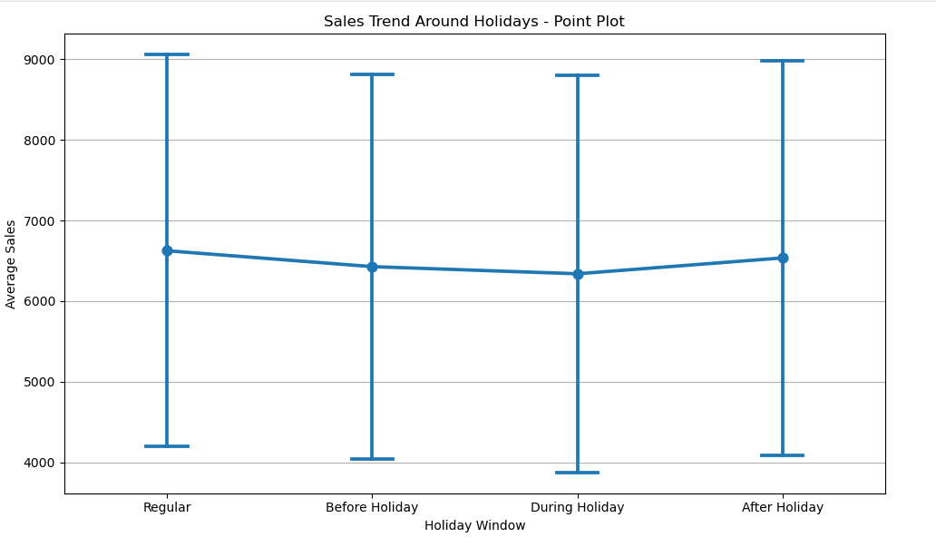
Sales before and after holidays
Lowest Sales During Holidays:
The graph shows that average sales drop significantly during holidays, likely due to store closures or reduced operating hours.
Sales Spike After Holidays:
There's a noticeable increase in sales after holidays, suggesting a post-holiday shopping surge, possibly driven by delayed purchases or post-holiday promotions.
Stable Sales Before Holidays: Sales are relatively high before holidays, potentially due to pre-holiday shopping activity.
Normal Days Perform Well:
Interestingly, normal (non-holiday) days have almost the highest average sales, indicating they form a strong baseline.

Slide 6
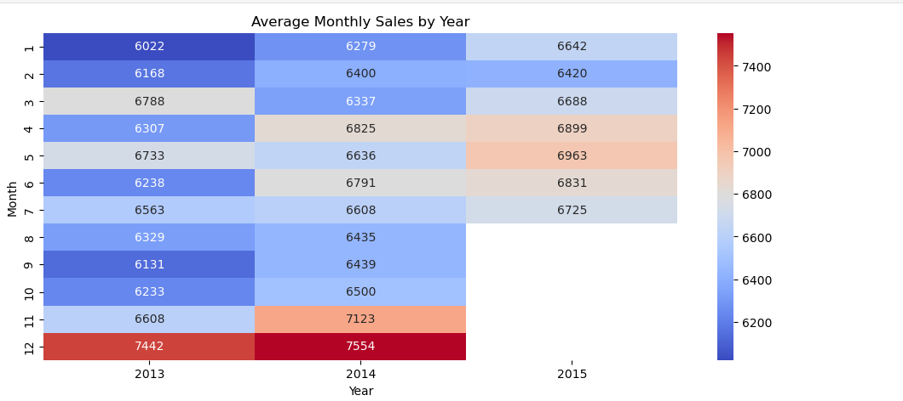
Average Month Sale By Year
December records the highest average sales, indicating a strong year-end demand (possibly due to holidays, bonuses, or festive shopping).
July also shows a notable sales peak, possibly driven by mid-year promotions or events.
Low Sales Periods:
May has the lowest average sales, which could indicate a seasonal dip—possibly a lull after spring holidays or promotional gaps.
Steady Periods:
Sales are relatively stable from January to April with a slight upward trend.
August to October reflects a minor dip or stagnation in average sales before the sharp rise in November and December.

Slide 7
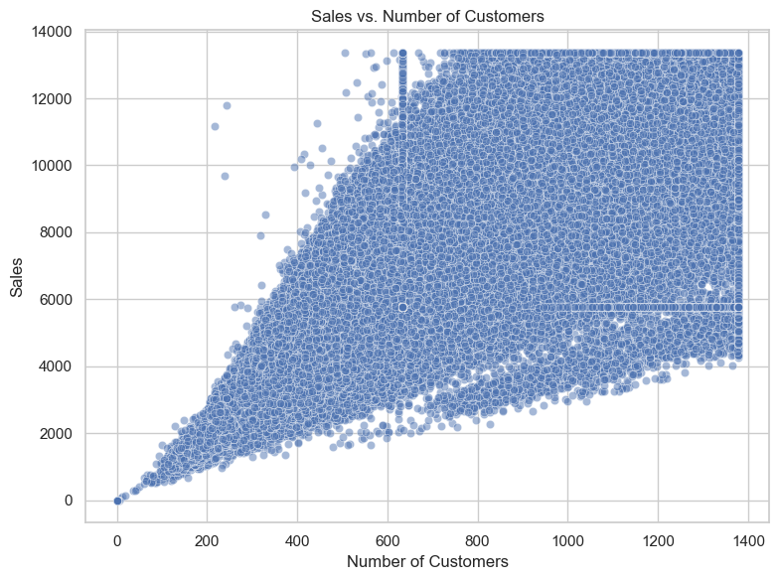
Correlation Between Customer And Sales
The scatter plot shows a clear upward trend, indicating a strong positive correlation between the number of customers and sales — as the number of customers increases, sales tend to increase as well.
Sales Saturation Zones:
A visible horizontal band appears around 6000 in sales, regardless of customer count, indicating a possible price cap or product limit (e.g., fixed price items or promotion thresholds).
Similarly, many values are concentrated at specific customer counts (like 600, 1200), possibly indicating store-specific capacities or reporting artifacts.
Wide Spread at Higher Customer Counts:
While low customer numbers correspond to low sales, higher customer numbers show more variability in sales, suggesting variation in purchasing behavior per customer (e.g., not all customers buy the same quantity/value).

Slide 8
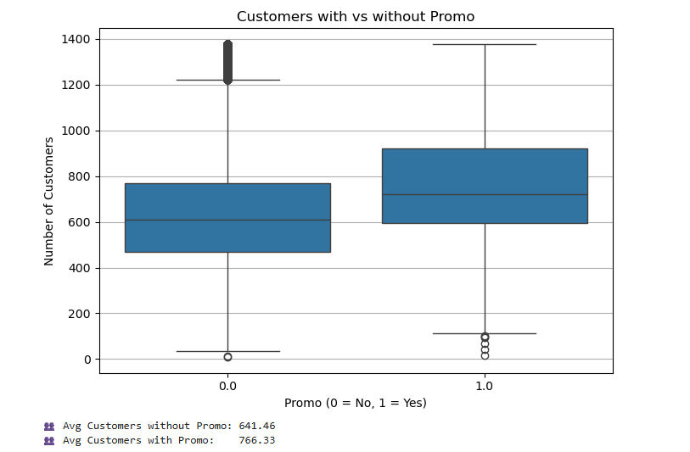
Sales During Prome and Sales During Non-Promo
The presence of a promotion positively influences customer spending behavior, indicating that promotions are effective at encouraging customers to spend more per visit.
Conclusion:
Promotions lead to a noticeable uplift in per-customer sales, making them a valuable tool for driving revenue. This supports the inclusion of the Promo variable as an important feature in any predictive modeling or marketing decision-making.

Slide 9
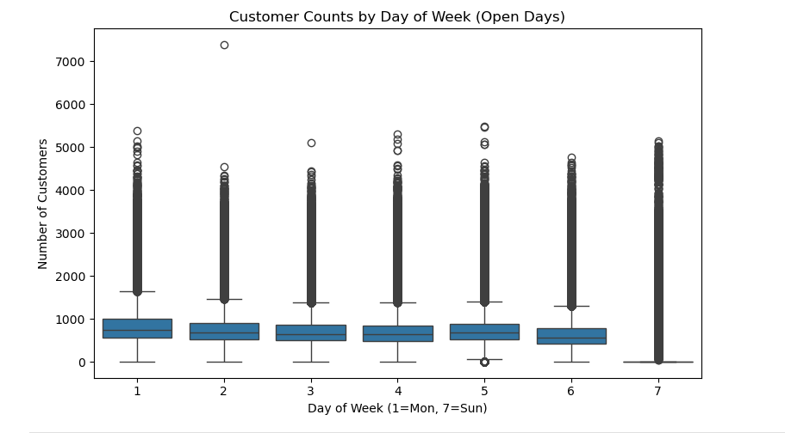
Sales Per Day(Monday - Saturday)
Sales dip sharply during holidays, likely due to store closures or reduced footfall.
Post-holiday sales spike, suggesting customer return and promotional push.
Normal days consistently outperform holiday-related days, reinforcing the impact of holidays on revenue.
Recommendation: Plan promotions immediately after holidays and explore strategies to keep select stores open during low-activity holidays.

Slide 10
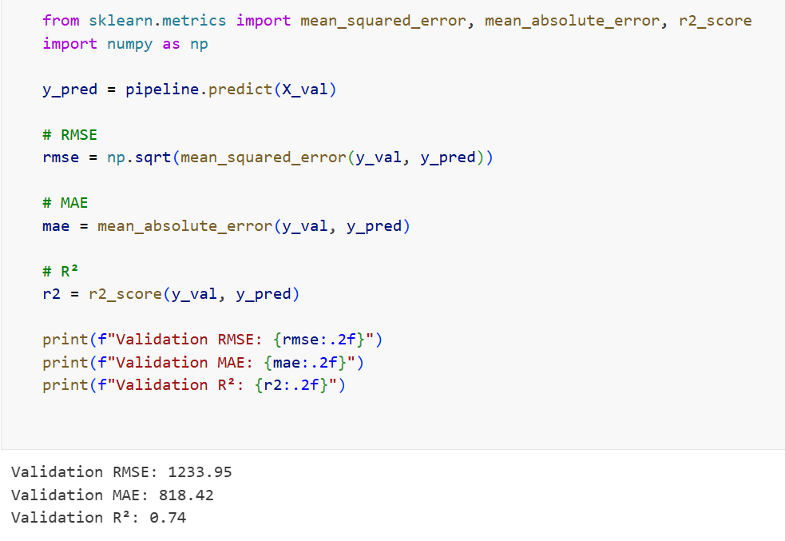
ML Modeling
RMSE (Root Mean Squared Error): 1233.95
Measures the average difference between predicted and actual values
Squares errors before averaging (so larger errors are penalized more)
In this case, the model's predictions are typically off by about $1,234
Lower is better (0 would be perfect)
MAE (Mean Absolute Error): 818.42
Similar to RMSE but without squaring the errors
Represents the average absolute difference between predictions and reality
Here, predictions are off by about $818 on average
Often easier to interpret than RMSE
R² (R-squared): 0.74
Shows what percentage of the variation in the data is explained by the model
Ranges from 0 (no explanation) to 1 (perfect explanation)
0.74 means the model explains 74% of the variability - quite good!

Slide 11
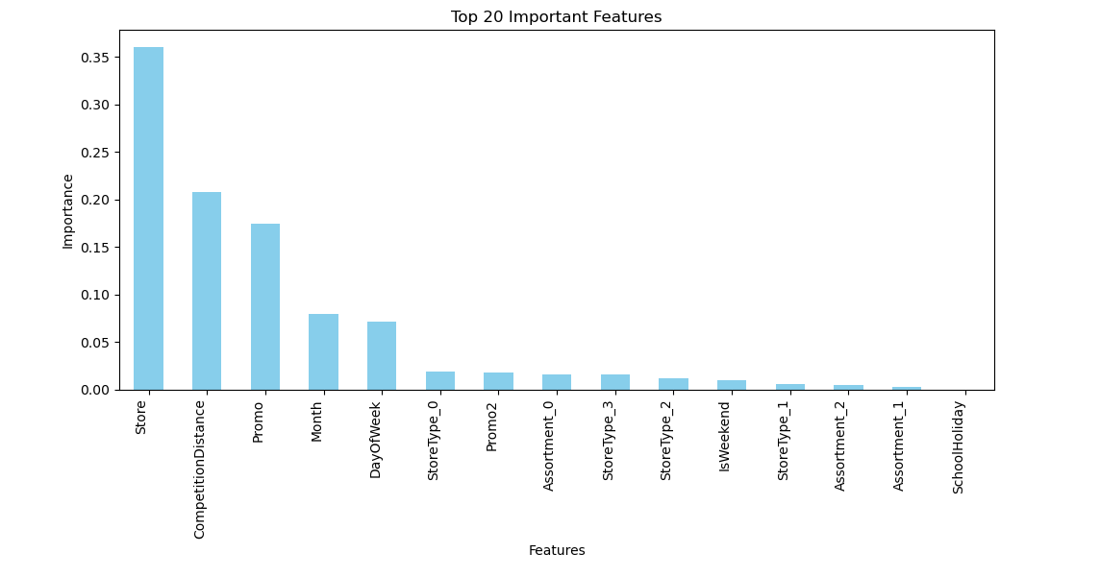
Features Importance
Store ID is the most impactful feature, confirming that each store has distinct sales behavior.
Promotions and Month are strong sales drivers, reflecting seasonality and marketing influence.
Day of the Week impacts buying behavior, with clear weekday/weekend patterns.
Store characteristics like StoreType and Assortment contribute meaningfully but less than dynamic features.
Insights from feature importance can guide targeted promotions and store-level strategies.

Slide 12
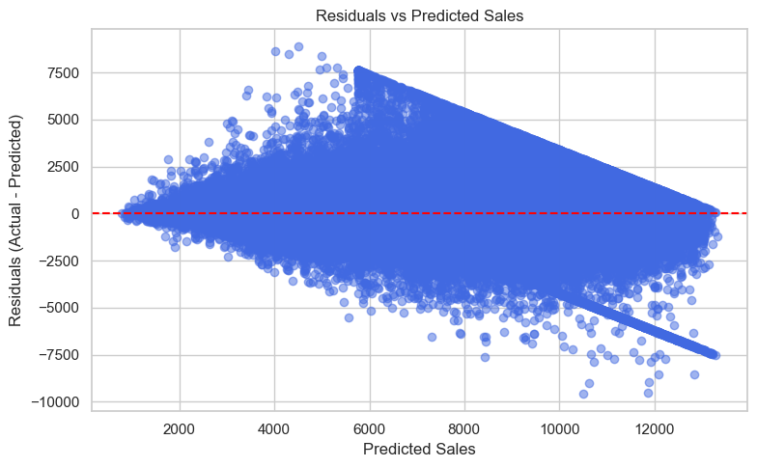
Residual Analysis
Residuals are mostly centered around zero Model has low overall bias
Indicates need for additional features or different model complexity for high-sales stores.
Overprediction trend at high sales suggests opportunity for model fine-tuning.
Residual spread increases with predicted sales Model performs better on low-sales predictions,

Slide 13
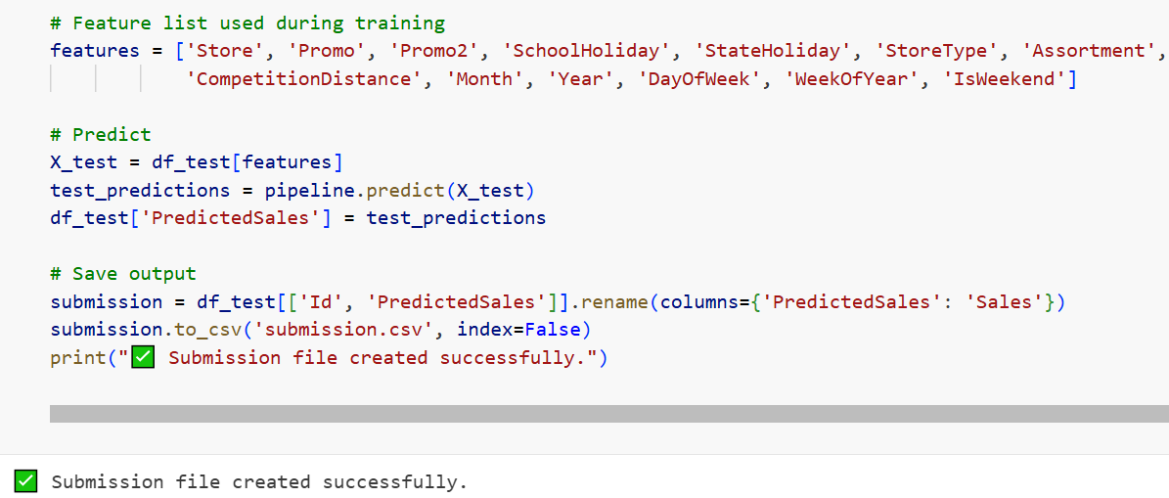
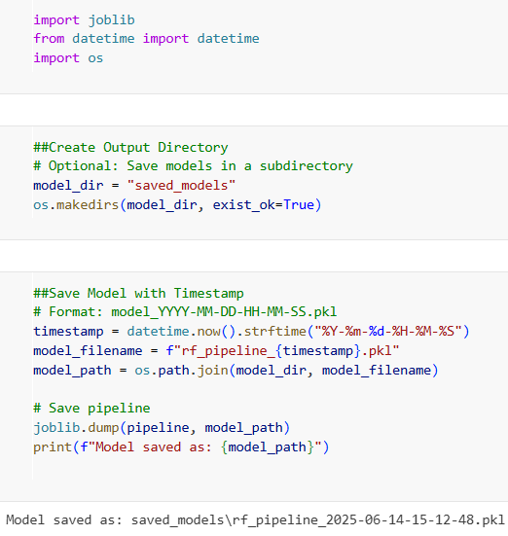
Deep Learning

Slide 14
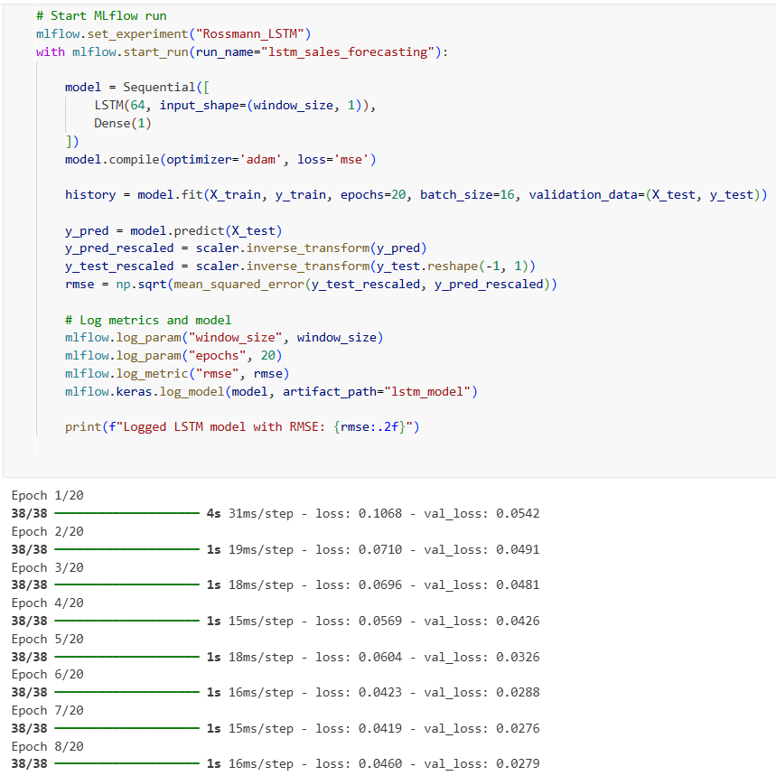
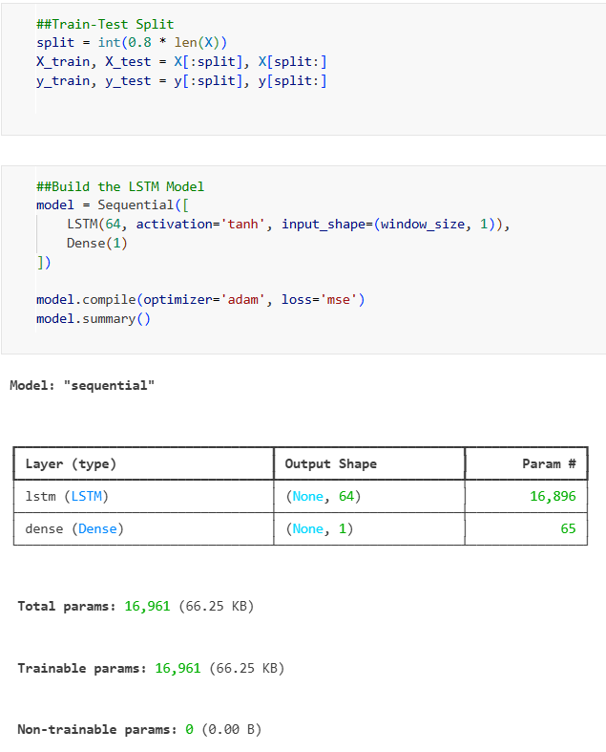
Deep Learning

Slide 15
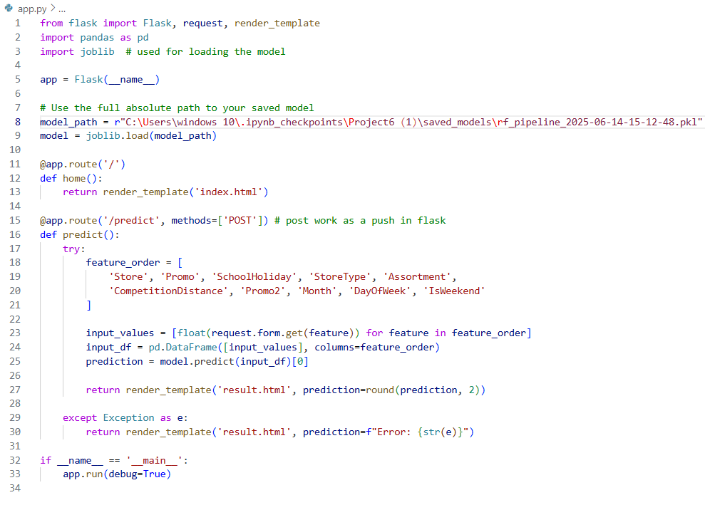
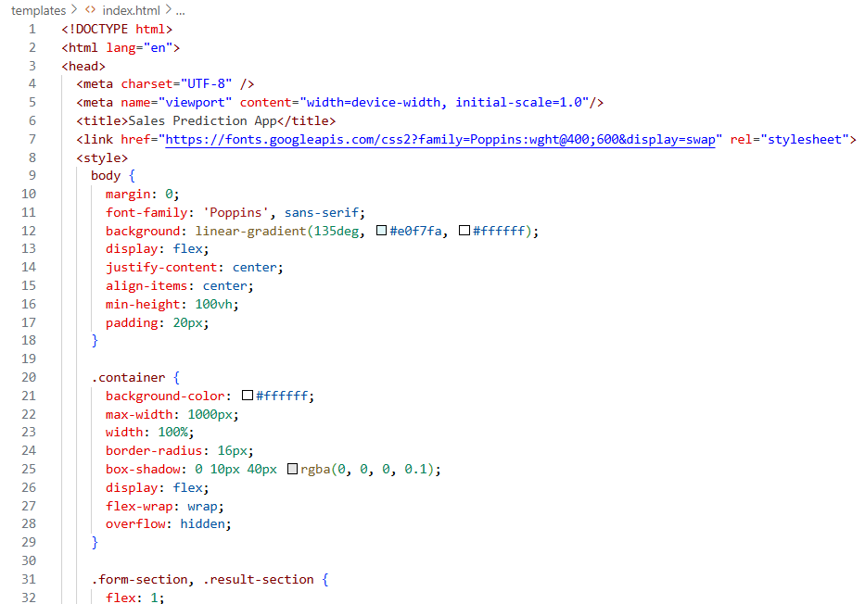
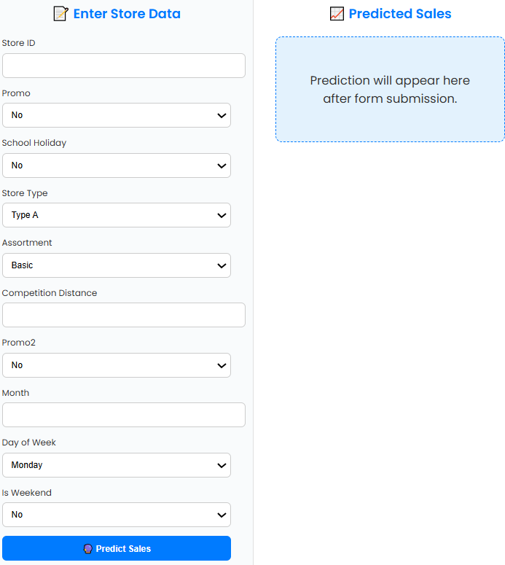
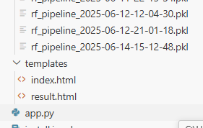
HTML , app.py

Slide 16

Thank You

